Slide 1
Memory Management of Fools Engine
Work in progress

Slide 2
Areas with custom memory allocation strategies
Area |  | Allocation strategy
Gameplay World | Components | ECS A
 | Behaviors, Systems and Components’ dynamic data | “Isolator” allocator A
Assets | Components | ECS B
 | Components’ dynamic data | “Isolator” allocator B
 | Assets’ Data | Virtual multipool allocator
Frame lifetime related memory | Full pipeline | Ring buffer allocator
 | Single stage | Monotonic allocator
Very short-lived memory |  | “Scratchpad” allocator

Slide 3
ECS
EnTT library with sparse set data structure per component type with manual memory pagination directly from malloc, and that is OK in this case.
Frame pipeline single stage related lifetime memory – Monotonic allocator
std::pmr::monotonic_buffer_resource with static initial buffer and malloc as upstream allocator. Reset after every stage with release of additional buffers.

Slide 4
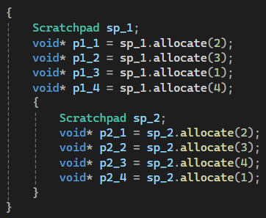
Very short-lived memory
Scratchpad allocator
Basic idea:
Thread local stack of bump allocators compatible with std::pmr

Slide 5
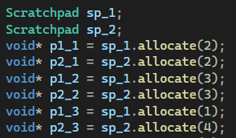
Very short-lived memory
Scratchpad allocator
Obvious issue:
Interlocking allocations
Can happen implicitly when Scratchpad allocator is passed to std::pmr containers (allocation when they grow)!

Slide 6
Very short-lived memory
Scratchpad allocator
Solution:
Bitflag per allocator indicating whether to roll back the pointer or not
Every allocation sets flags of younger allocators to false
? | ? | 1 | ? | ? | ?
? | ? | 1 | ? | ? | ?
? | ? | 1 | 1 | ? | ?
? | ? | 1 | 0 | ? | ?
? | ? | 1 | 0 | ? | ?
? | ? | 1 | 0 | ? | ?

Slide 7
Very short-lived memory
Scratchpad allocator
Optimalizations:
Setting rollback flags to false on all positions to the right regardless of allocators’ existence
Resetting rollback flag to true and rollback pointer when “reclaiming” front
? | ? | 1 | 1 | ? | ?
A
? | ? | 1 | 0 | 0 | 0
B
? | ? | 1 | 1 | 0 | 0
reclaimed
? | ? | 1 | 1 | 0 | 0
? | ? | 1 | 1 | 0 | 0

Slide 8
Frame pipeline related lifetime memory
Ring buffer allocator
Rendering
Simulation
Rendering
Simulation
Rendering
Rendering
Simulation
Rendering
Simulation
Simulation
Rendering
Simulation
Rendering
Rendering
Rendering
Simulation
Rendering

Slide 9
Behaviors, Systems and Components’ dynamic data “Isolator” allocator
Smallest pool
Biggest pool
Linear step
Segregator <4096> | Segregator <128> | StaticMultipool< 8, 128, 8 >
 |  | Segregator <256> | DynamicMultipool< 144, 256, 16 >
 |  |  | Segregator <512> | DynamicMultipool< 288, 512, 32 >
 |  |  |  | Segregator <1024> | DynamicMultipool< 576, 1024, 64 >
 |  |  |  |  | Segregator <2048> | DynamicMultipool< 1152, 2048, 128 >
 |  |  |  |  |  | DynamicMultipool< 2304, 4096, 256 >
 | malloc
StaticMultipool
Fixed array of pools
DynamicMultipool
Fixed array of pointers to pools initialized with nullptrs
Chunks keep track of allocated blocks count and get released when empty
Pools keep chunks forever
When whole pool is empty, it gets destroyed and released too

